Slide 1
Cryptography using GPGPU
Presented By : TY81 CS-D
Uttkarsh Patel (81)
Atharv Natu (63)
Sneha Palwe (75)
Bhavin Patil (66)
Guided By : Prof. Swati Jadhav

Slide 2
What is GPGPU ?
GPGPU stands for General Purpose Graphical Processing Units.
GPGPUs are used for tasks that were formerly the domain of high-power CPUs, such as physics calculations, encryption/decryption, scientific computations and the generation of cryptocurrencies such as Bitcoin.
Because graphics cards are constructed for massive parallelism, they can dwarf the calculation rate of even the most powerful CPUs for many parallel processing tasks. The same shader cores that allow multiple pixels to be rendered simultaneously can similarly process multiple streams of data at the same time.
Currently, there are 2 parallel platforms available known as OpenCL and CUDA.

Slide 3

What is CUDA ?
Reference - https://en.wikipedia.org/wiki/CUDA
CUDA stands for Compute Unified Device Architecture
It is a parallel computing platform and programming model created by NVIDIA for general computing on graphical processing units (GPUs). It enables developers to dramatically speed up computing applications by harnessing the power of GPUs.
In addition to accelerating High Performance Computing (HPC) and research applications, CUDA has also been widely adopted across consumer and industrial ecosystems.
While there have been other proposed APIs for GPUs, such as OpenCL, and there are competitive GPUs from other companies, such as AMD, the combination of CUDA and NVIDIA GPUs dominates several application areas, including deep learning, and is a foundation for some of the fastest computers in the world.

Slide 4
How CUDA Works ?
CUDA is not just an API or programming language or SDK. It is mainly a hardware component allowing drivers and libraries to run on top of it. The entire code is divided into 2 parts on the basis of execution - CPU and GPU.
In GPU-accelerated applications, the sequential part of the workload runs on the CPU - which is optimized for single-threaded performance, while the compute intensive portion of the application runs on thousands of GPU cores in parallel.

Slide 5
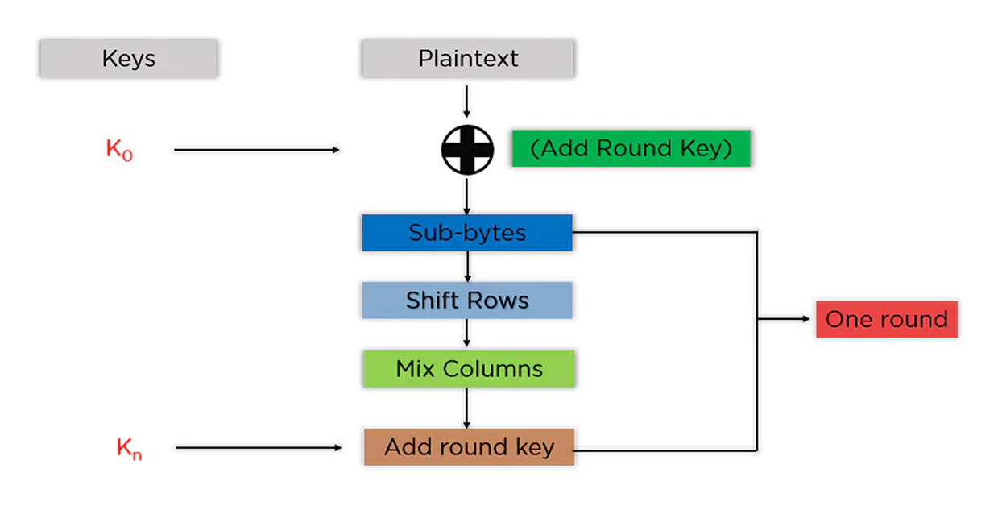
AES Encryption and Decryption
Reference - https://www.simplilearn.com/tutorials/cryptography-tutorial/aes-encryption

Slide 6
Sample Code
__device__ void sub_bytes(BYTE state[], BYTE sbox[])
{
for (int i = 0; i < LENGTH; i++)
state[i] = sbox[state[i]];
}
__device__ void add_round_key(BYTE state[], BYTE round_key[])
{
for (int i = 0; i < LENGTH; i++)
state[i] = state[i] ^ round_key[i];
}

Slide 7
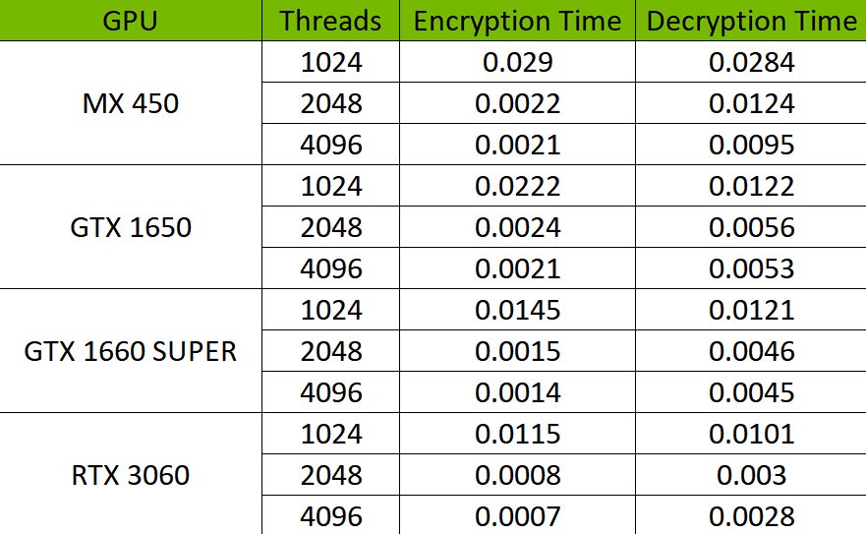
Results

Slide 8
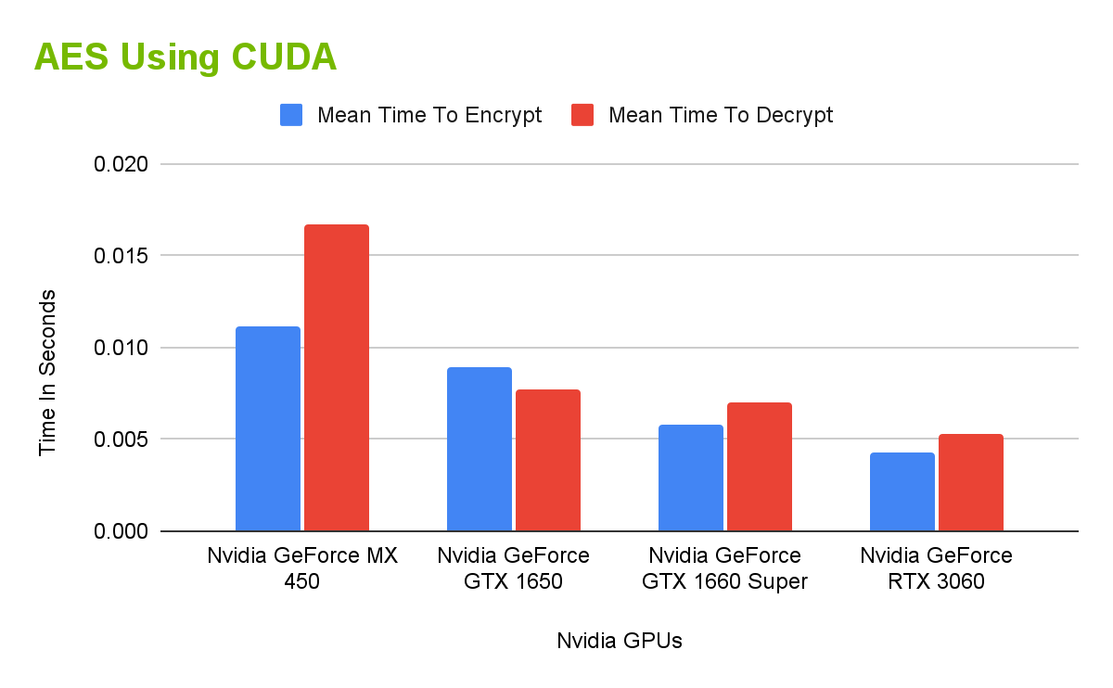

Slide 9
References
Cihangir Tezcan (2021). Optimization of Advanced Encryption Standard on Graphics Processing Units IEEE Access 10.1109/ACCESS.2021.3077551
Manjit Jaiswal, Rani Kumari, Itti Singh (2018). Analysis And Implementation Of Parallel Aes Algorithm Based On T-table Using Cuda On The Multicore Gpu, IJCRT | Volume 6, Issue 1 January 2018 | ISSN: 2320-2882
Jianwei Ma, Xiaojun Chen, Rui Xu, Jinqiao Shi (2017). Implementation and Evaluation of Different Parallel Designs of Aes Using Cuda, IEEE Second International Conference on Data Science in Cyberspace
Ahmed A. Abdelrahman, Mohamed M. Fouad and Hisham Dahshan (2017). High Performance CUDA AES Implementation: A Quantitative Performance Analysis Approach, IEEE Computing Conference 2017.
Canhui Wang , Xiaowen Chu (2019). GPU Accelerated AES Algorithm, https://arxiv.org/abs/1902.05234v1

Slide 10
Thank You

